Slide 1
Japanese Whiskey review analysis
Minyang Wang
Xueqing Wang
Notes:
Main purpose is to figure out the features of different whisky bottle according to their reviews by using topic modeling and classification models.

Slide 2
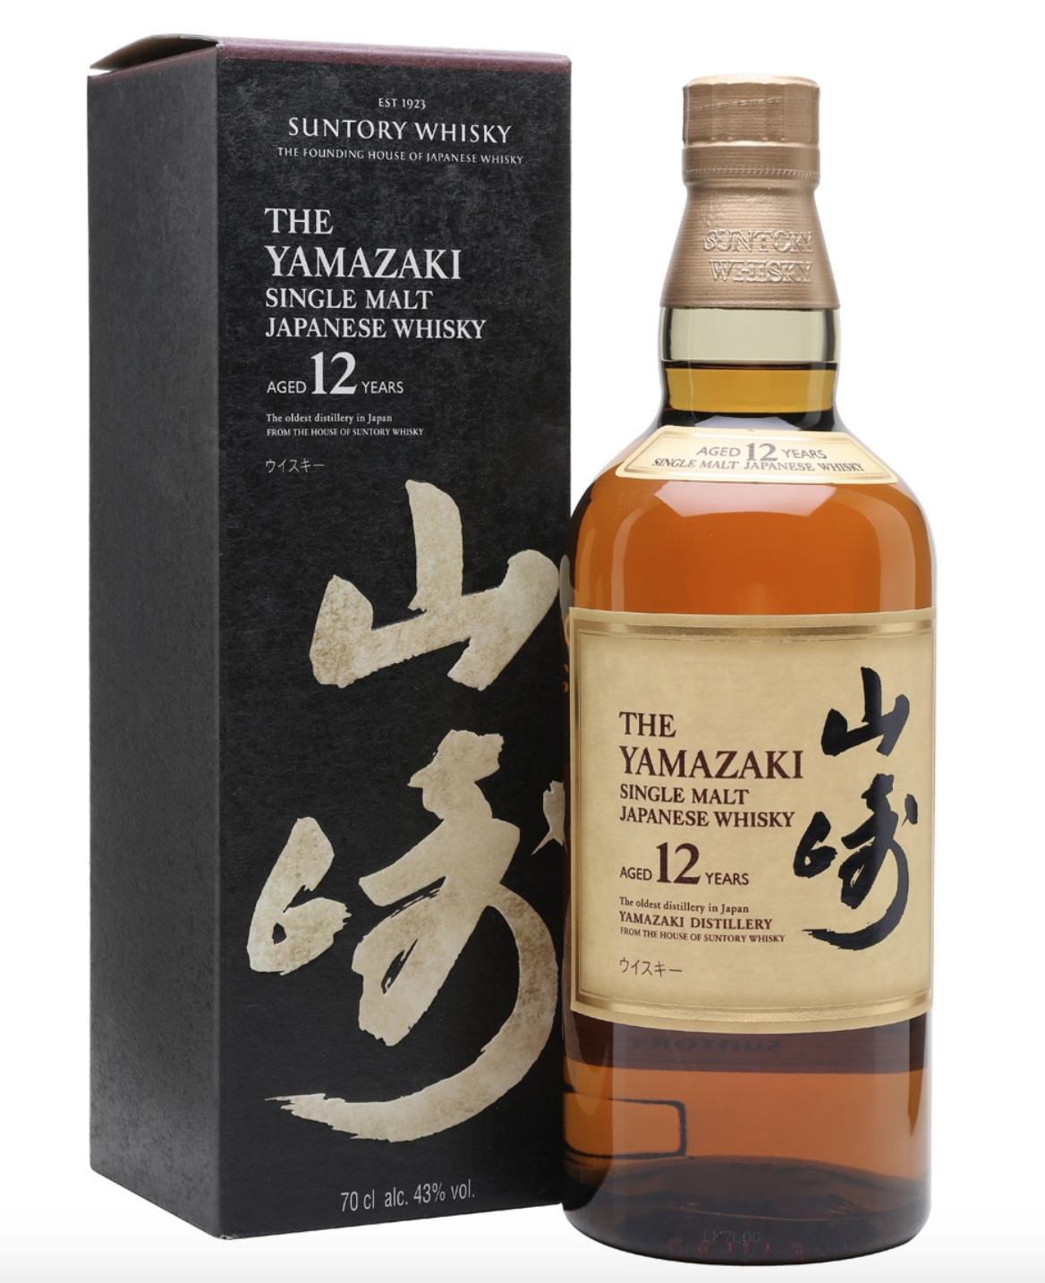

Yamazaki Sherry Cask 2016
Yamazaki 12 Year Old
Data
Nikka Whisky from the Barrel

Slide 3
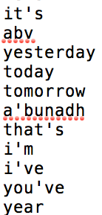
Topic modeling Method
Add Extra Stop Words
Overall Topic Modeling
Tune the parameters
Number of Topics : 3
Optimize Interval : 15, 10
Each Whiskey Topic Modeling
Tune the parameters
Number of Topics : 5, 3, 2
Optimize Interval : 15, 10

Slide 4
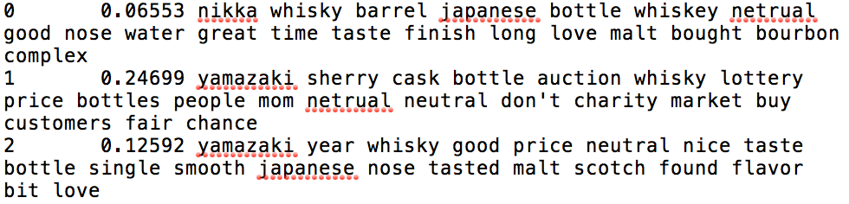
Overall Topic Modeling
Best Result Settings:
--num-topics 3
--optimize-interval 10
Nikka Whiskey From the Barrel
Yamazaki Sherry 2016
Yamazaki 12 Years Old

Slide 5
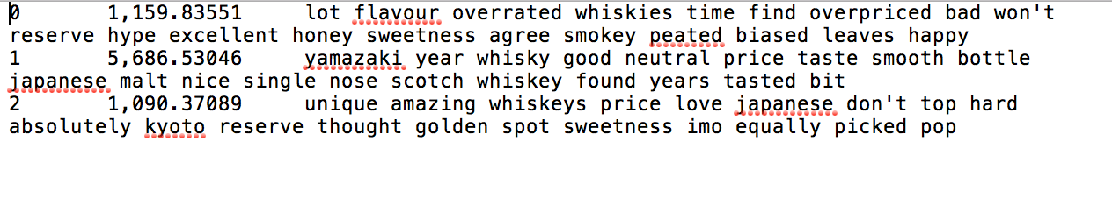
Yamazaki 12 Years Old Topic Modeling
Best Result Settings:
--num-topics 3
--optimize-interval 15
Overrate
Neutral
Positive

Slide 6
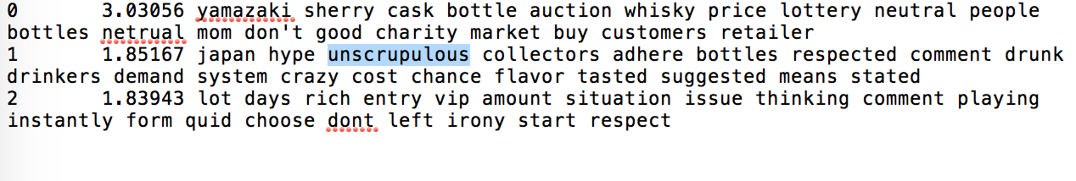
Yamazaki Sherry 2016 Topic Modeling
Best Result Settings:
--num-topics 3
--optimize-interval 15
Lottery/ Auction
Criticize the the selling system
Seller’s behavior

Slide 7
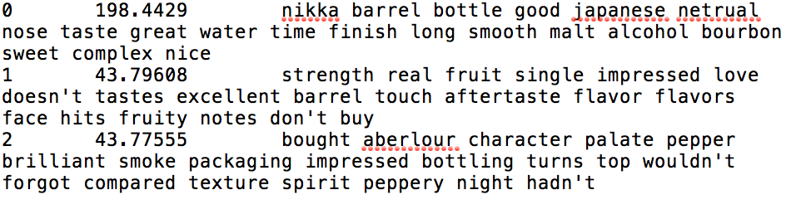
Nikka Whisky From the Barrel Topic Modeling
Best Result Settings:
--num-topics 3
--optimize-interval 15
Taste
Fruity
Peppery

Slide 8
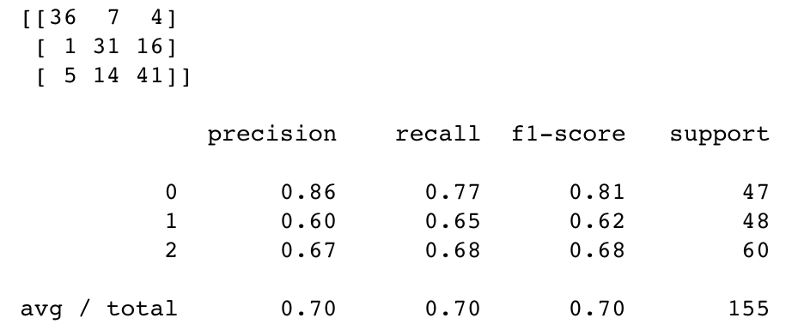
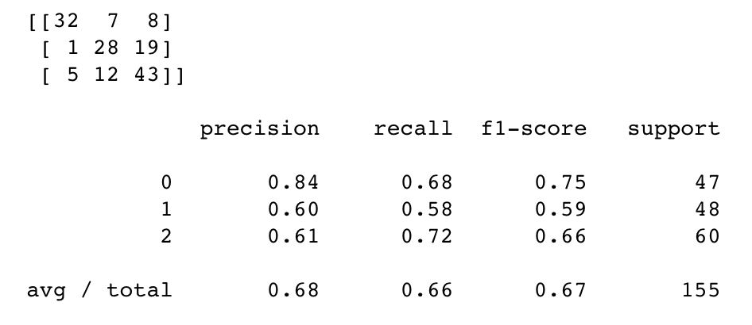
Whiskey bottle classification
 | 3-folds Cross Validation |  |  | Hold out test (40% testing data)
 | Uni-gram | N-gram | TFIDF | Uni-gram | N-gram | TFIDF
SVM | 59.6% | 59.6% | 68.9% | 63.9% | 63.2% | 66.5%
MNB | 72.6% | 72.6% | 70.8% | 69.7% | 69.7% | 62.6%
Yamazaki Sherry
Yamazaki 12 Year
Nikka Whisky
SVM
MNB
Notes:
Use different models to learn the patterns and feature words of different bottle, by using cross-validation and hold out test to evaluate how well those patterns can distinguish the reviews of different bottles.

Slide 9
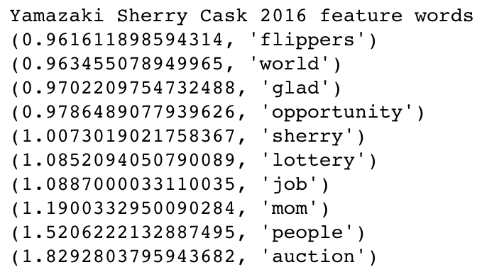
“Lottery..... I agree. Auction.... disgrace! Yes it's for charity. but you're going to push the average joe's chances of ever getting a bottle to almost nil. I give to charity on a monthly basis and choose to do so. but this should not be forced upon us. I expected better from Master of Malt.”
Document frequency | Yamazaki Sherry | Yamazaki 12 | Nikka
auction | 33% | 0 | 0
lottery | 25% | 0 | 0
MoM | 21.7% | 0.8% | 2%
charity | 10.4% | 0 | 0
flippers | 7% | 0 | 0
Notes:
So we went back to the reviews…to see how those feature words can distinguish the reviews
Auction appears 62 times

Slide 10
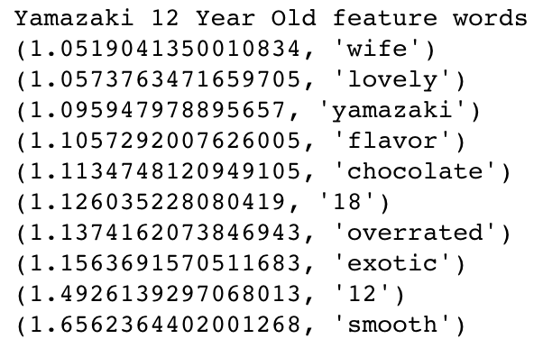

“… My wife searched for a bottle for me …”
“…Received as a birthday gift from my wife and… ”
“… I was surprised and disappointed when my wife bought me a bottle…”
“…have purchased a 12 on recommendation of my wife…”
“Love this one. Perfect with chocolate.”
“The chocolate vaguely reminds me of…”
“We ate chocolate right before tasting this. So. we didn't get much citrus.”
“…prefer it to the Yamazaki 18 years…”
“…The 18yo is very interesting on the other hand. a bit pricy though…”
“…Wondering if it was worth it to purchase the Yamazaki 18…”
Taste is smooth.
Best gift for husband if he likes whiskey
Tastes better when pairing with chocolate
Taste is similar to Yamazaki 18 Years old, but much cheaper

Slide 11
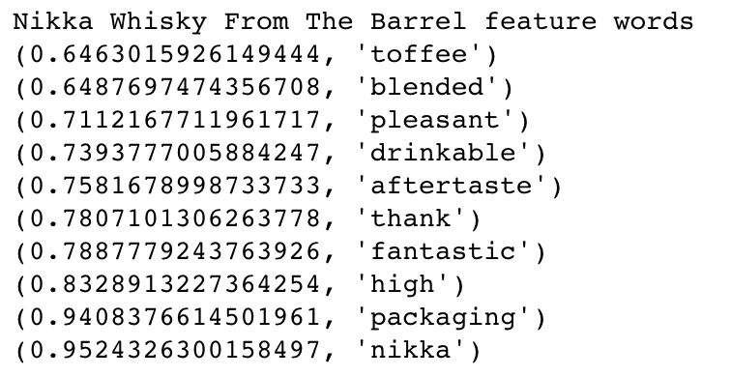
“…with a wonderful sweet toffee like finish…”
“…gives you a beautiful warm hug and a toffee kiss…”
“…aftertaste is somewhat killed by the burning sensation…”
“…Aftertaste goes on forever…”
“…wonderful aftertaste with a long and smooth taste of citrus…”
“…and excellent stand out packaging…”
“…Love the clinical packaging…”
“… It was packaged well so no chance of damage and the whiskey is presented in a chic black box…”
It’s a blended whiskey
Has toffee taste
The aftertaste is strong and lasts long
Beautiful packaging
Notes:
Toffee 12/150=8% blended 19/150=12.7% aftertaste packaging 11/150=7%

Slide 12
Business application
For product with limited amount of release, lottery receives more welcome than auction for most customers. While the website can sell the product both by lottery and auction, more portion of products are suggested to be sold by lottery.
For alcohol, customers care more on the accessibility of the product ( selling method and price), the taste, and the packaging of the product.

